Slide 1
Ranking Algorithms!
Graphing Connections

Slide 2
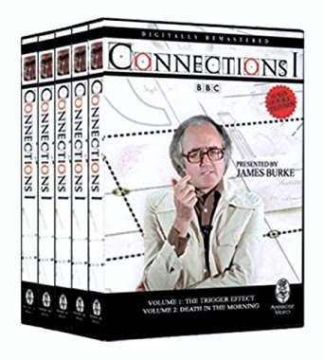


Slide 3
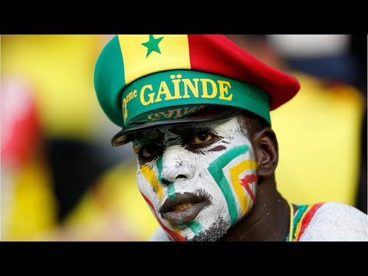
Start: Senegal!

Slide 4
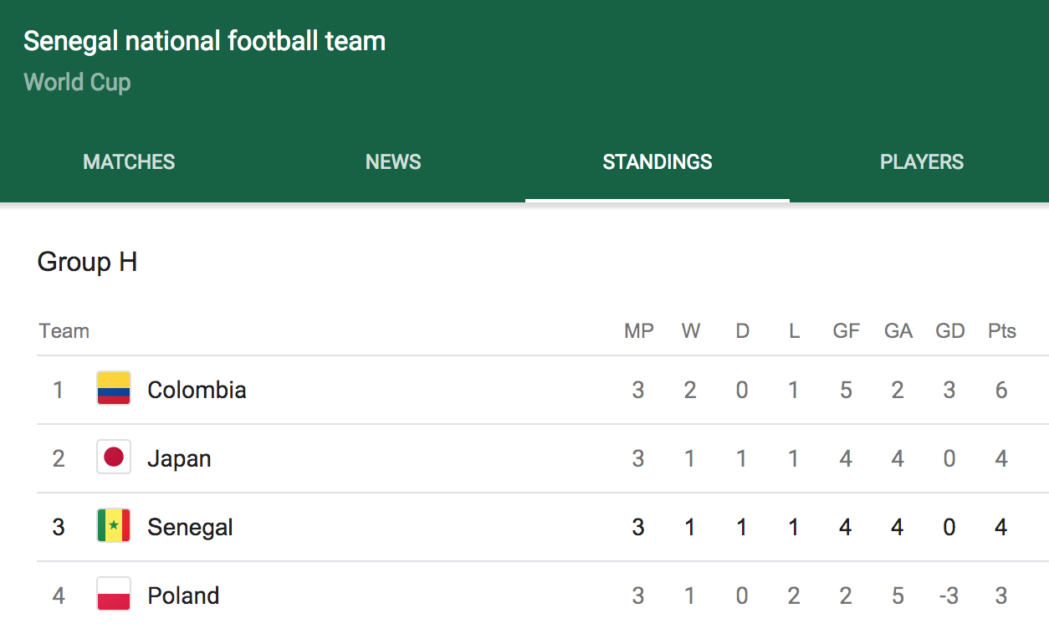

Slide 5
FIFA Tiebreakers
Highest number of points
Goal difference
Goals scored
Points obtained in group games between teams concerned
Goal difference from games involving teams concerned
Number of goals scored in games between teams concerned
Fair play points
Drawing of lots by FIFA

Slide 6
Spoiler - No good solution
Arrow's impossibility theorem:
No ranked voting scheme meets a surprisingly modest set of criteria:
Universal (always works, regardless of number of voters/choices)
Fair and consistent (if everyone perfers a to b, ranking prefers a to b)
Non-dictatorial
https://plato.stanford.edu/entries/arrows-theorem/

Slide 7
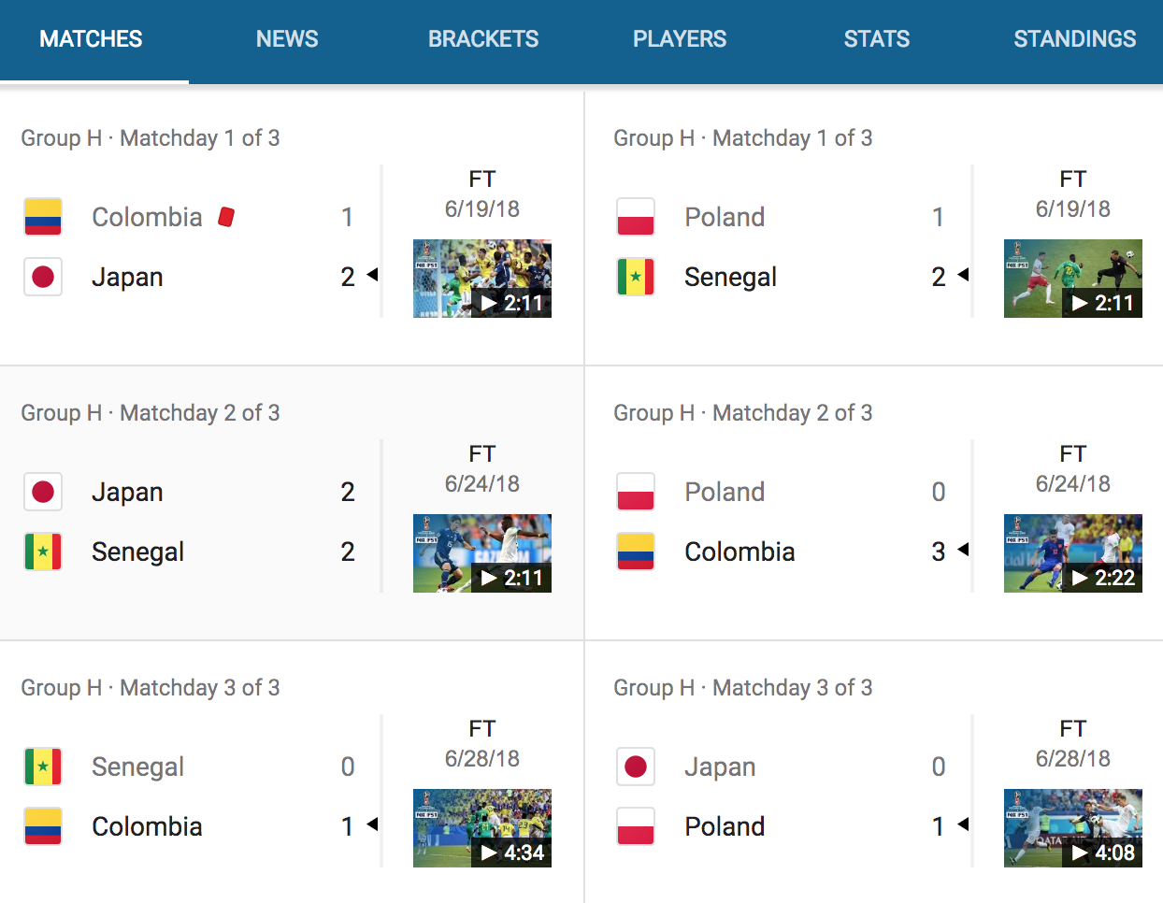
Mathematical representation: graph!
4 Teams 6 Games

Slide 8
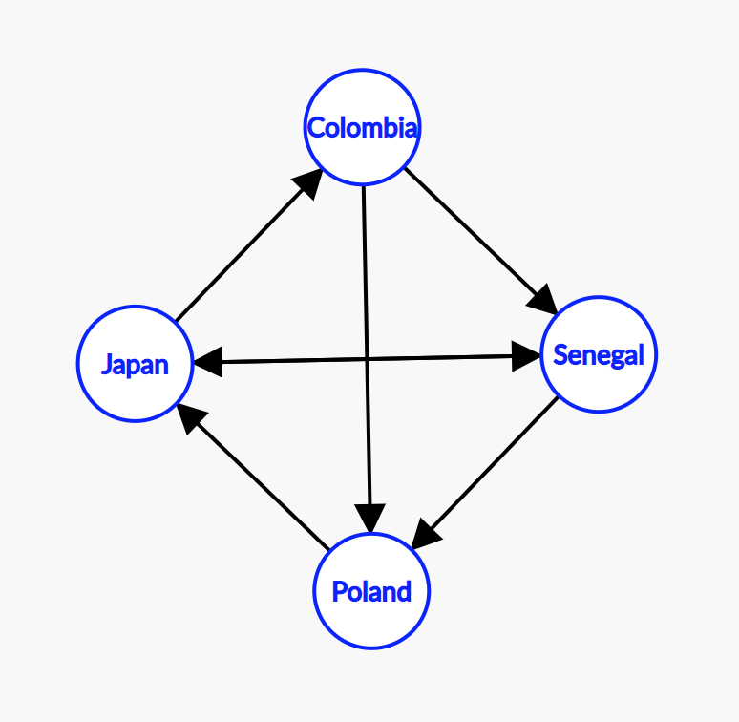
Mathematical representation: graph!

Slide 9
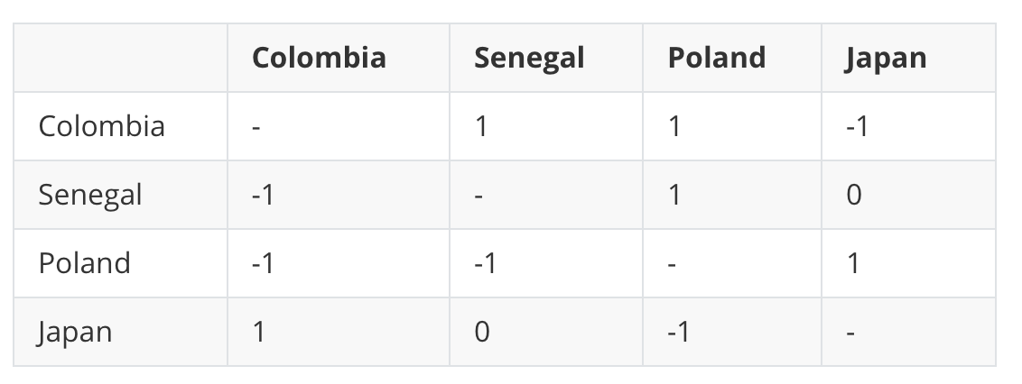
Mathematical representation: Matrix!

Slide 10
Many applications
Sports -> Tournament
Nodes = Teams, Vertices = Wins
Google -> Rank pages
Nodes = Pages, Vertices = Inbound links
Twitter -> Rank influential people in social graph
Nodes = Users, Vertices = Follow (Facebook=undirected graph)
Biology
Nodes = Patients, Vertices = Who caught an STD from whom

Slide 11
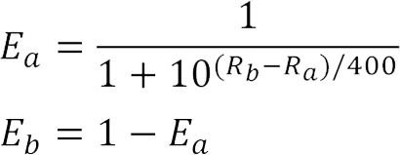
2 Ranking Schemes!
ELO - Arpad Elo:
http://stephenwan.net/thoughts/2012/10/02/elo-rating-system.html
https://en.wikipedia.org/wiki/Elo_rating_system

Slide 12

“The Social Network”

Slide 13
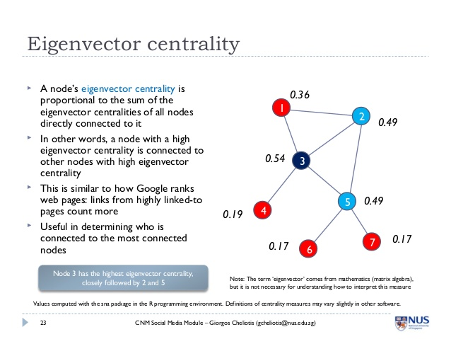
Eigenvector centrality -> PageRank

Slide 14
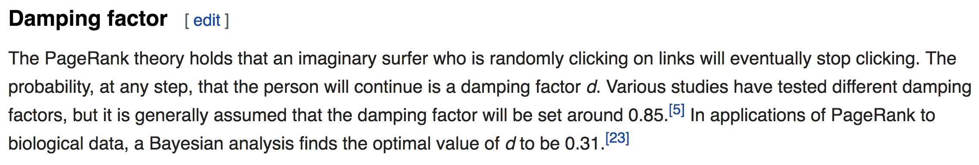
PageRank: The $100 Billion Eigenvector
You have a billion pages to rank: it’s a very large matrix.
Enter the damping factor:
https://www.rose-hulman.edu/~bryan/googleFinalVersionFixed.pdf
https://en.wikipedia.org/wiki/PageRank

Slide 15
Questions?

